Slide 1
Functional Dependency & Normalization

Slide 2
Dependency
A dependency occurs in a database when information stored in the same database table uniquely determines other information stored in the same table.

Slide 3
Functional Dependency
A functional dependency is defined as a constraint between two sets of attributes in a relation from a database.
Given a relation R, a set of attributes X in R is said to functionally determine another attribute Y, also in R, (written X → Y) if and only if each X value is associated with at most one Y value.

Slide 4
A Functional Dependency describes a relationship between attributes within a single relation.
An attribute is functionally dependent on another if we can use the value of one attribute to determine the value of another.
We use the arrow symbol → to indicate a functional dependency. X → Y is read X functionally determines Y

Slide 5
In other words….
X is the determinant set and Y is the dependent attribute. Thus, given a tuple and the values of the attributes in X, one can determine the corresponding value of the Y attribute.

Slide 6
Example
Employee
SSN | Name | JobType | DeptName
557-78-6587 | Lance Smith | Accountant | Salary
214-45-2398 | Lance Smith | Engineer | Product
Note: Name is functionally dependent on SSN because an employee’s name can be uniquely determined from their SSN. Name does not determine SSN, because more than one employee can have the same name..

Slide 7
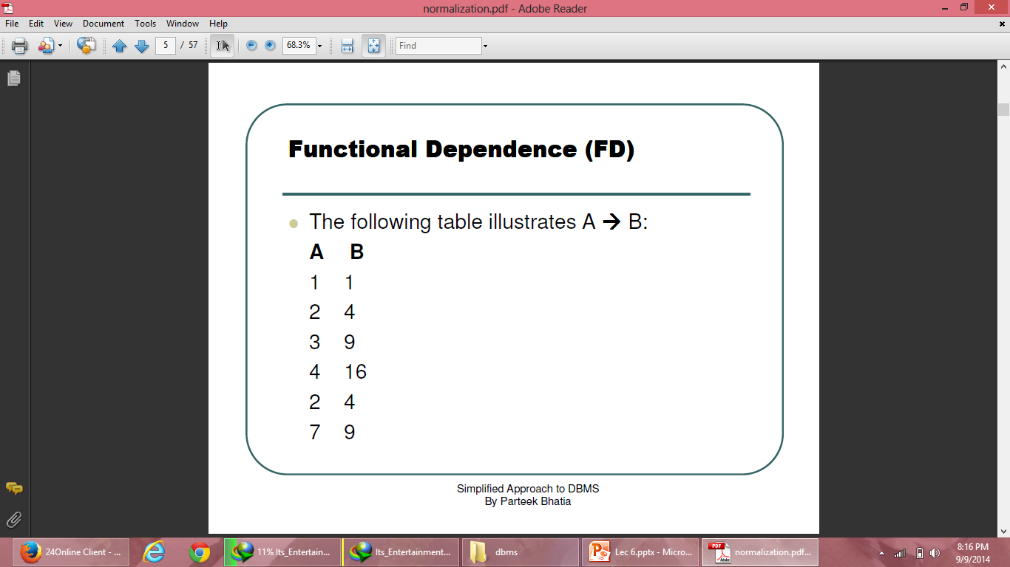
Functional Dependence (FD)

Slide 8
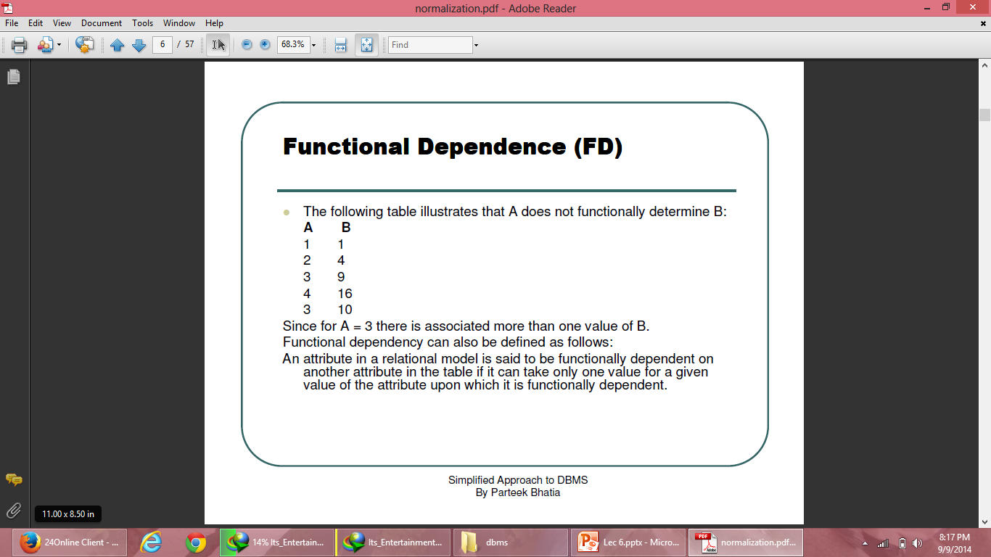
Functional Dependence (FD)

Slide 9
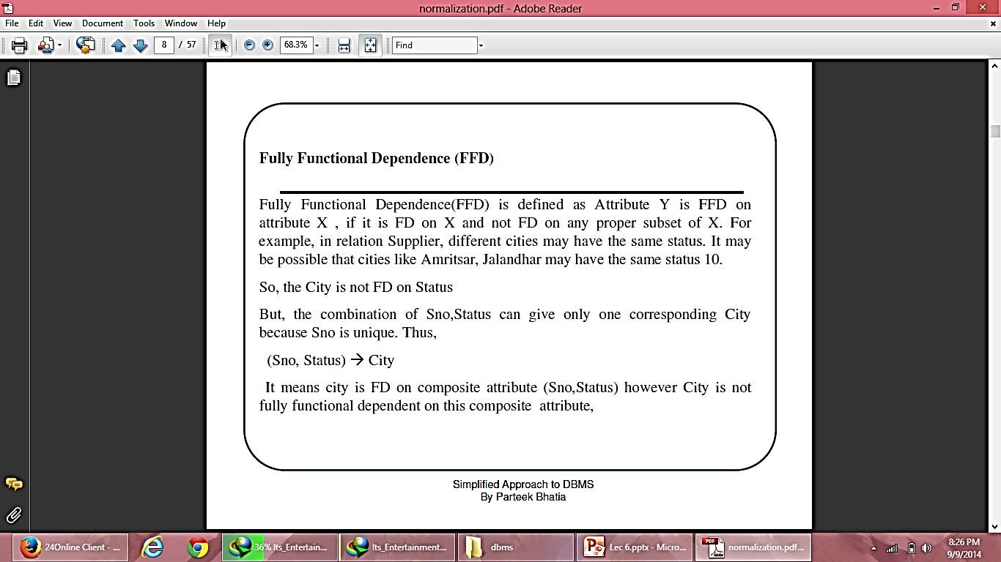
Fully Functional Dependency

Slide 10
Primary Functional Dependency (PFD)
A Partial Functional Dependency is a functional dependency where the determinant consists of key attributes, but not the entire primary key, and the determined consists of non-key attributes.
A Transitive Functional Dependency is a functional dependency where the determinant and the determined both consists of non-key attributes.

Slide 11
Primary Functional Dependency (PFD)
A Multi-Value Dependency (MVD) occurs when two or more independent multi valued facts about the same attribute occur within the same table. It means that if in a relation R having A, B and C as attributes, B and C are multi-value facts about A, which is represented as A →→ B and A →→ C, then multi value dependency exist only if B and C are independent on each other.

Slide 12
Trivial Functional Dependency
Trivial: If an FD X → Y holds where Y is subset of X, then it is called a trivial FD. Trivial FDs always hold.
Non-trivial: If an FD X → Y holds where Y is not subset of X, then it is called non-trivial FD.

Slide 13
Closure
Let a relation R have some functional dependencies F specified. The closure of F (usually written as F+) is the set of all functional dependencies that may be logically derived from F.
F+, the closure, is the set of all the functional dependencies including F and those that can be deduced from F.
The closure is important and may, for example, be needed in finding one or more candidate keys of the relation.

Slide 14
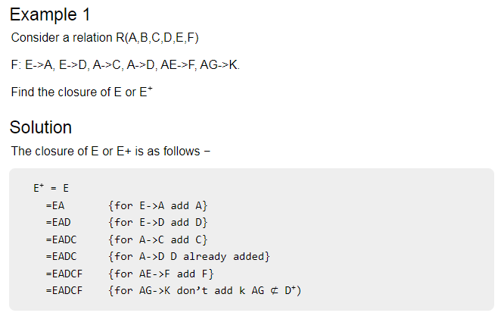
Example of closure

Slide 15
Find the closure(Class Exercise)
Let the relation R(A,B,C,D,E,F)
F: B->C, BC->AD, D->E, CF->B.
Find the closure of B

Slide 16
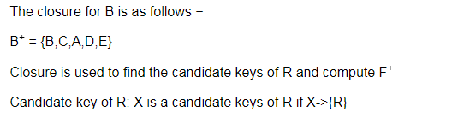
Solution of Class Exercise

Slide 17
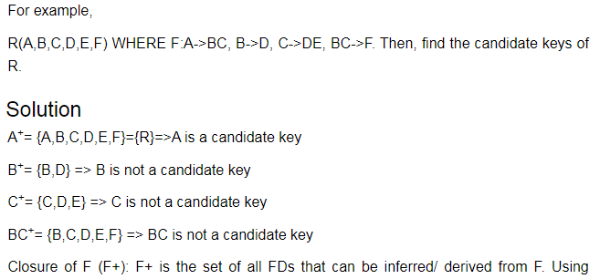
Examples of Closure

Slide 18
How to find Candidate Keys and Super Keys using Attribute Closure?
If attribute closure of an attribute set contains all attributes of relation, the attribute set will be super key of the relation.
If no subset of this attribute set can functionally determine all attributes of the relation, the set will be candidate key as well.
Note: Candidate key is the minimal super key

Slide 19
Example 3
Consider the relation scheme R = {E, F, G, H, I, J, K, L, M, N} and the set of functional dependencies {{E, F} -> {G}, {F} -> {I, J}, {E, H} -> {K, L}, K -> {M}, L -> {N} on R. What is the candidate key for R?
A. {E, F} B. {E, F, H} C. {E, F, H, K, L} D. {E}

Slide 20
Finding attribute closure of all given options, we get: {E,F}+ = {EFGIJ} {E,F,H}+ = {EFHGIJKLMN} {E,F,H,K,L}+ = {EFHGIJKLMN} {E}+ = {E}
{EFH}+ and {EFHKL}+ results in set of all attributes, but EFH is minimal. So it will be candidate key. So correct option is (B).

Slide 21
Axioms
Developed by Armstrong in 1974, there are six rules (axioms) that all possible functional dependencies may be derived from them.

Slide 22
Axioms Cont…
1. Reflexivity Rule --- If X is a set of attributes and Y is a subset of X, then X → Y holds.
each subset of X is functionally dependent on X.
2. Augmentation Rule --- If X → Y holds and W is a set of attributes, then WX → WY holds.
3. Transitivity Rule --- If X → Y and Y → Z holds, then X → Z holds.

Slide 23
Derived Theorems from Axioms
4. Union Rule --- If X → Y and X → Z holds, then X → YZ holds.
5. Decomposition Rule --- If X → YZ holds, then so do X → Y and X → Z.
6. Pseudotransitivity Rule --- If X → Y and WY → Z hold then so does WX → Z.

Slide 24
Normalization
Data normalization is a technique of organizing the data in database.
Normalization of data can be defined as a process during which redundant relation schemas are decomposed by breaking up their attributes into smaller relation schemas that process desirable properties.

Slide 25
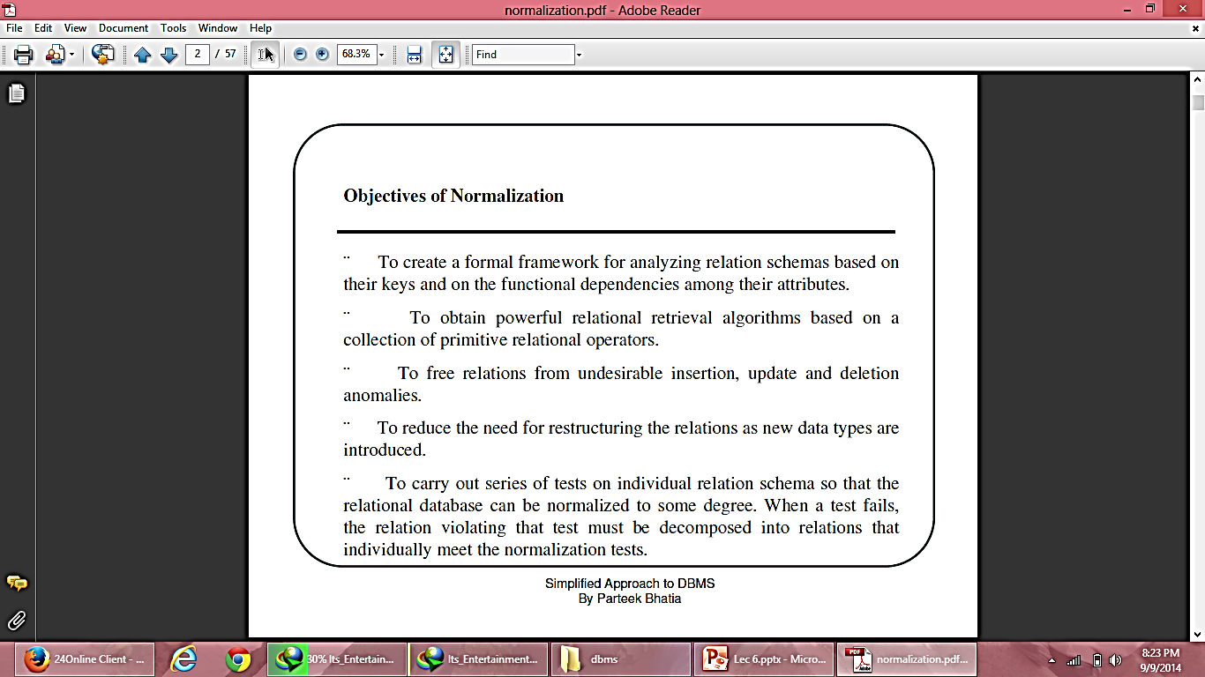
Objectives of Normalization

Slide 26
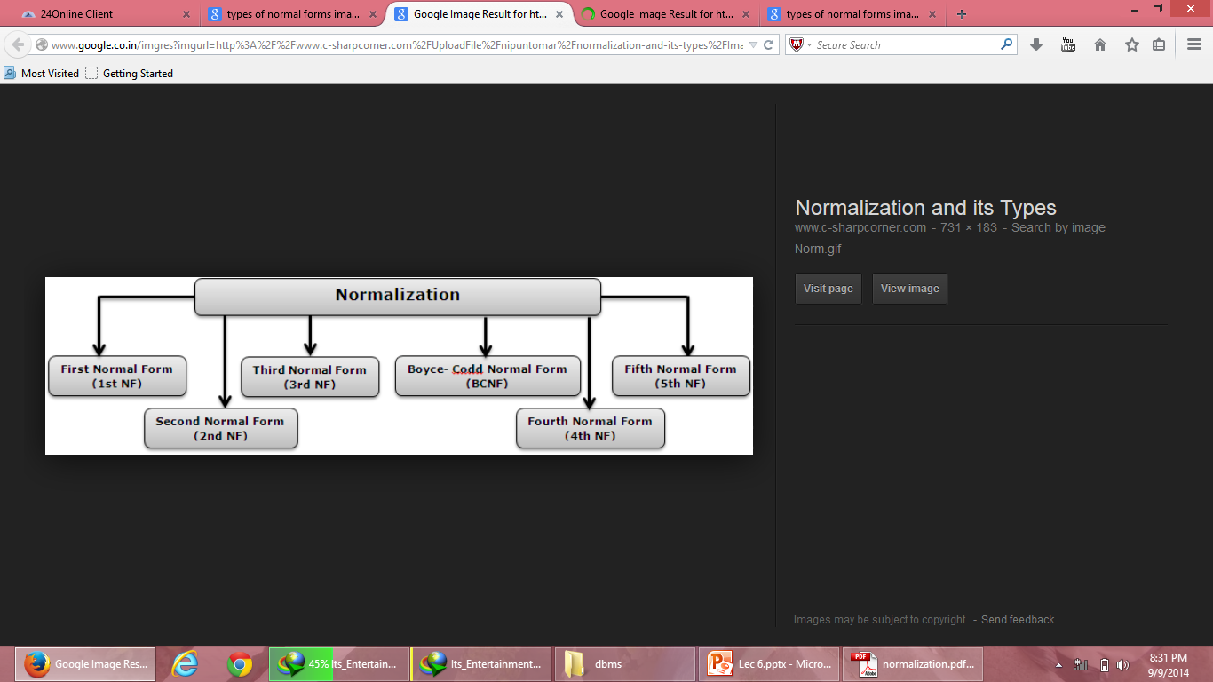
Normal Forms

Slide 27
First Normal Form
A relation is said to be in 1NF if and only if every cell/entry of the relation has at most a single value. In other words “a relation is in 1NF if and only if all underlying domains contain atomic values or single value only.”
The objective of normalizing a table is to remove its repeating groups and ensure that all entries of the resulting table have at most a single value.

Slide 28
Example: Unnormalized table
Course Code | Course Name | Teacher Name | Roll No | Name | System Used | Hourly Rate | Total Hours
C1 | Visual Basic | ABC | 100 | A1 | P – I | 20 | 7
 |  |  | 101 | A2 | P – II | 30 | 3
 |  |  | 102 | A3 | Celeron | 10 | 6
 |  |  | 103 | A4 | P – IV | 40 | 1
C2 | Oracle & Dev | DEF | 100 | A1 | P – I | 20 | 7
 |  |  | 104 | A5 | P – III | 35 | 3
 |  |  | 105 | A6 | P – II | 30 | 1
 |  |  | 101 | A2 | P – II | 30 | 2
C3 | C++ | KJP | 106 | A7 | P – IV | 40 | 3
 |  |  | 107 | A8 | P – IV | 40 | 2
 |  |  | 108 | A9 | P – I | 20 | 1
C4 | Java | Kumar | 109 | A10 | Cyrix | 20 | 2

Slide 29
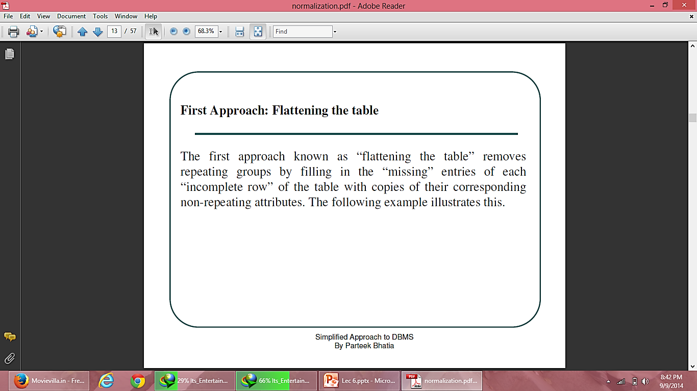
Approaches to normalize table
In general, there are two basic approaches to normalize tables.

Slide 30
STUDENT (Flattening) (Normalized Table)
Course Code | Course Name | Teacher Name | Roll No | Name | System Used | Hourly Rate | Total Hours
C1 | Visual Basic | ABC | 100 | A1 | P – I | 20 | 7
C1 | Visual Basic | ABC | 101 | A2 | P – II | 30 | 3
C1 | Visual Basic | ABC | 102 | A3 | Celeron | 10 | 6
C1 | Visual Basic | ABC | 103 | A4 | P – IV | 40 | 1
C2 | Oracle & Dev | DEF | 100 | A1 | P – I | 20 | 7
C2 | Oracle & Dev | DEF | 104 | A5 | P – III | 35 | 3
C2 | Oracle & Dev | DEF | 105 | A6 | P – II | 30 | 1
C2 | Oracle & Dev | DEF | 101 | A2 | P – II | 30 | 2
C3 | C++ | KJP | 106 | A7 | P – IV | 40 | 3
C3 | C++ | KJP | 107 | A8 | P – IV | 40 | 2
C3 | C++ | KJP | 108 | A9 | P – I | 20 | 1
C4 | Java | Kumar | 109 | A10 | Cyrix | 20 | 2

Slide 31
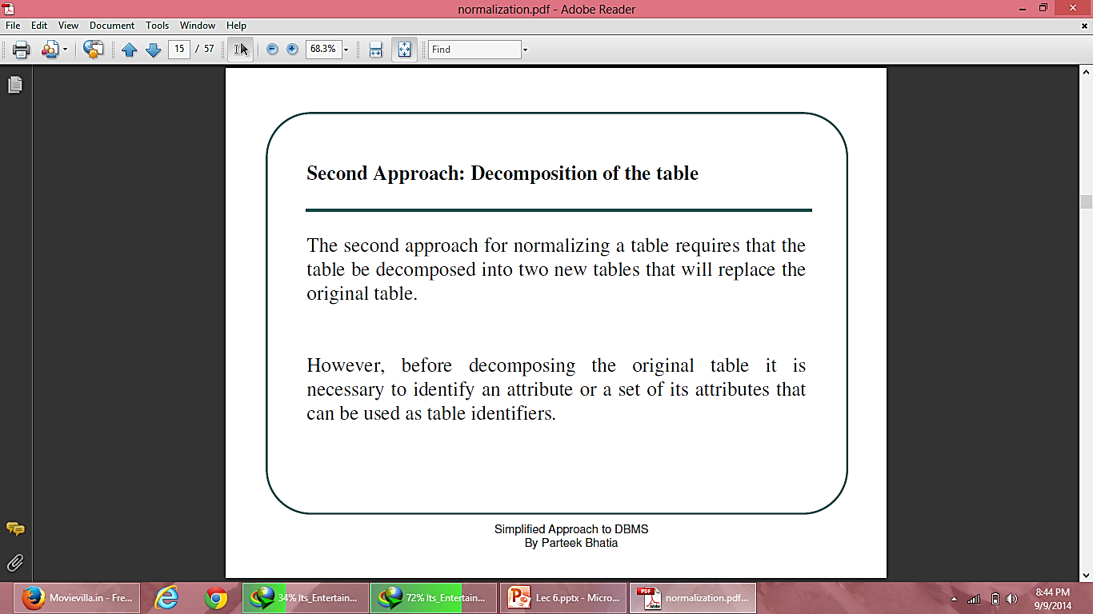
Approaches to normalize table

Slide 32
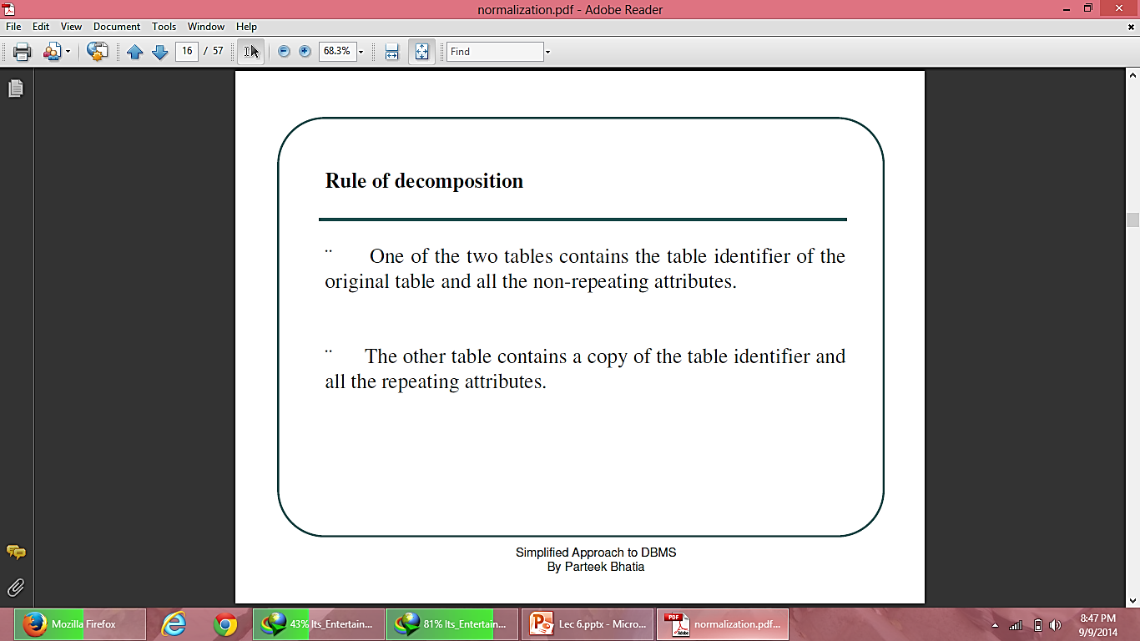

Slide 33
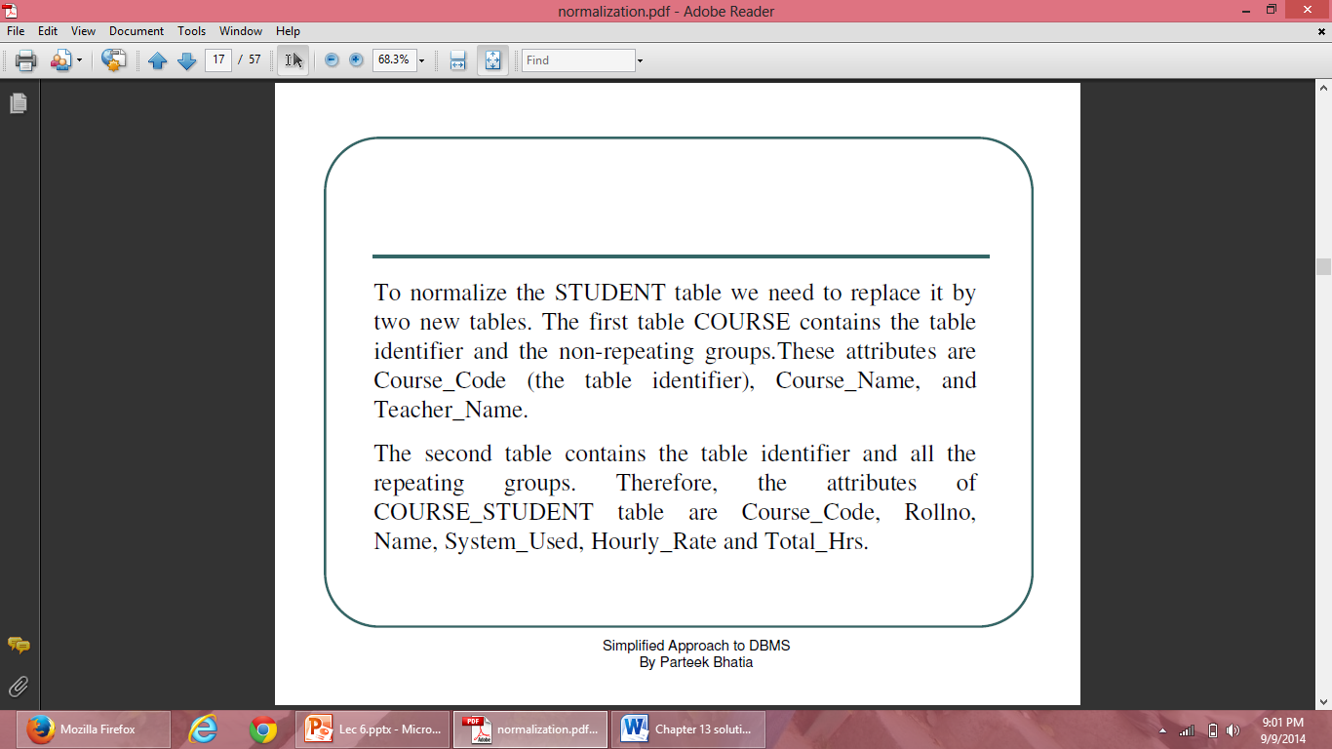

Slide 34
STUDENT (Decomposition) (Normalized Table)
COURSE
Course Code | Roll No | Name | System Used | Hourly Rate | Total Hours
C1 | 100 | A1 | P – I | 20 | 7
C1 | 101 | A2 | P – II | 30 | 3
C1 | 102 | A3 | Celeron | 10 | 6
C1 | 103 | A4 | P – IV | 40 | 1
C2 | 100 | A1 | P – I | 20 | 7
C2 | 104 | A5 | P – III | 35 | 3
C2 | 105 | A6 | P – II | 30 | 1
C2 | 101 | A2 | P – II | 30 | 2
C3 | 106 | A7 | P – IV | 40 | 3
C3 | 107 | A8 | P – IV | 40 | 2
C3 | 108 | A9 | P – I | 20 | 1
C4 | 109 | A10 | Cyrix | 20 | 2
Course Code | Course Name | Teacher Name
C1 | Visual Basic | ABC
C2 | Oracle & Dev | DEF
C3 | C++ | KJP
C4 | Java | Kumar
COURSE_STUDENT
PK = (Course_code, RollNo)

Slide 35
Anomalies in 1NF Relations
Redundancies in 1NF relations lead to a variety of data anomalies.
1. Insert anomalies:
We cannot insert the information about the student until he joins any course e.g. we cannot store information about the roll no 110 until he join any course, similarly we are unable to store the information about the course until there is a student who enroll into that course.
These anomalies occur because course_code, rollno is the composite key and we cannot insert null in any of these two attributes.

Slide 36
Anomalies in 1NF Relations
2. Update anomalies:
This relation is also susceptible to update anomalies because the course in which a student studies may appear many times in the table. If a teacher moves to another course, we are now faced with two problems: we either search the entire table looking for that teacher and update his or her course_code value or we miss one or more tuples of that STUDENT and end up with an inconsistent database. For small tables, this type of anomaly may not seem to be much of a problem.
But for larger tables this may cause the problem of inconsistency.

Slide 37
Anomalies in 1NF Relations
Delete anomalies:
This relation experiences deletion anomalies whenever we delete the last tuple of a particular student. In this case, we not only delete the course information that connects that student to a particular course, but also lose other information about the system on which this student works.
Let us consider, the case where we have to delete the information of student having rollno 109, then we also lose the information about course_code C4 . Also if we have to delete the information of java course we lose the information about the student Kumar.

Slide 38
Second Normal Form (2NF)
A relation R is in 2NF if and only if it is in 1NF and every non-key attribute is fully functional dependent on the primary key.
Name
RollNo
System_Used
Functional Dependence Diagram
Cours_Code
Hourly_Rate
Course_Name
Total Hrs.
Teacher_Name

Slide 39
Second Normal Form (2NF)
A resultant database of 1NF Course_Code does not satisfy above rule, because non-key attributes Name, System_Used and Hourly_Rate are not fully dependent on the primary key (Course_Code, Rollno) because Name, System_Used and Hourly_Rate are functional dependent on Rollno and Rollno is a subset of the primary key so it does not hold the law of fully functional dependence.

Slide 40
Rule to convert 1NF to 2NF
Consider a relation where a primary key consists of attributes A and B. These two attributes determine all other attributes.
Attribute C is fully dependent on the key.
Attribute D is partially dependent on the key because we only need attribute A to functionally determine it.
Attributes C and D are non-key attributes.

Slide 41
Rule to convert 1NF to 2NF
The rule is to replace the original relation by two new relations. The first new relation has three attributes: A, B and C. The primary key of this relation is (A, B) i.e. the primary key of the original relation. The second relation has A and D as its only two attributes. Observe that attribute A has been designated, as the primary key of the second relation and that attribute D is now fully dependent on the key.

Slide 42
Rule to transform 1NF to 2NF
A*
A*
A*
B*
Convert To
B*
D
C
C
D
1NF
2NF

Slide 43
Second Normal Form (2NF)
HOURS_ASSIGNED
STUDENT_SYSTEM_CHARGE
Course Code | Roll No | Total Hours
C1 | 100 | 7
C1 | 101 | 3
C1 | 102 | 6
C1 | 103 | 1
C2 | 100 | 7
C2 | 104 | 3
C2 | 105 | 1
C2 | 101 | 2
C3 | 106 | 3
C3 | 107 | 2
C3 | 108 | 1
C4 | 109 | 2
Roll No | Name | System Used | Hourly Rate
100 | A1 | P – I | 20
101 | A2 | P – II | 30
102 | A3 | Celeron | 10
103 | A4 | P – IV | 40
100 | A1 | P – I | 20
104 | A5 | P – III | 35
105 | A6 | P – II | 30
101 | A2 | P – II | 30
106 | A7 | P – IV | 40
107 | A8 | P – IV | 40
108 | A9 | P – I | 20
109 | A10 | Cyrix | 20
COURSE
Course Code | Course Name | Teacher Name
C1 | Visual Basic | ABC
C2 | Oracle & Dev | DEF
C3 | C++ | KJP
C4 | Java | Kumar

Slide 44
Removal of Anomalies of 1NF Relations
Insert Anomalies: It is now possible to insert the information about the student who does not join any course e.g. we can store the information about the Rollno 110 who does not join any course in STUDENT_SYSTEM_CHARGE database. Similarly now we are able to store the information about the course which has no enrolled student e.g. we can store that C1 course is of Visual Basic in COURSE table.

Slide 45
Removal of Anomalies of 1NF Relations
Update Anomalies: Now, it is possible to change the teacher for a particular course in the COURSE table through a single modification. So, no data inconsistency will arise.
Delete Anomalies: in the revised structure, we can delete the information of student having Rollno 109 without losing the information about his course i.e. C4.

Slide 46
Anomalies in 2NF
Relations in 2NF are still subject to data anomalies. Let us assume that the system on which a student works functionally determines the hourly rate charged from the student i.e.
System_Used → Hourly_Rate
Due to this fact the anomalies will occur in case of 2NF.

Slide 47
Anomalies in 2NF Relations
Insert Anomalies: Insertion anomalies occur in the Student_System_Charge relation. For example, consider a situation where we would like to set in advance the rate to be charged from the students for a particular system. We can not insert this info. Until there is a student assigned to that type of system because Rollno is the primary key for this relation and we can not insert the null value into it.

Slide 48
Anomalies in 2NF
Update Anomalies: Update anomalies will also occur in the Student_System_Charge relation because there may be several students which are working on the same type of the system. If the Hourly_Rate for a particular system changes, we need to make sure that the corresponding rate is changed for all the students that work on that type of system. Otherwise, the database may end up in an inconsistent state.

Slide 49
Anomalies in 2NF
Delete Anomalies: Delete anomalies will also occur in the Student_System_Charge relation. This type of anomaly occurs whenever we delete the tuple of a student who happens to be the only student left which is working on a particular system. In this case, we will also lose the information about the rate that we charge for that particular system.

Slide 50
Prime and nonprime attributes
An attribute of a relation schema R is called Prime attribute if it is a member of some candidate key of R.
An attribute is called non prime if it is not a prime attribute i.e. it is not the member of any candidate key.

Slide 51
Third Normal Form (3NF)
A relation R is in 3NF if and only if the following conditions are satisfied simultaneously:
R is already in 2NF
No nonprime attribute functionally determines any other nonprime attribute Or No nonprime attribute is transitively dependent on the key
The objective of transforming relations into 3NF is to remove all transitive dependencies.

Slide 52
Third Normal Form (3NF)
Functional Dependence Diagram
Name
RollNo
System_Used
RollNo → System_Used
System_Used → Hourly_Rate
It Means RollNo → Hourly_Rate
Hourly_Rate
Rule to Resolve Transitivity Dependence
A*
A*
B
B
Convert To
B
C
C
2NF
3NF

Slide 53
Third Normal Form (3NF)
STUDENT_SYSTEM_CHARGE
STUDENT_SYSTEM
Roll No | Name | System Used | Hourly Rate
100 | A1 | P – I | 20
101 | A2 | P – II | 30
102 | A3 | Celeron | 10
103 | A4 | P – IV | 40
100 | A1 | P – I | 20
104 | A5 | P – III | 35
105 | A6 | P – II | 30
101 | A2 | P – II | 30
106 | A7 | P – IV | 40
107 | A8 | P – IV | 40
108 | A9 | P – I | 20
109 | A10 | Cyrix | 20
Roll No | Name | System Used
100 | A1 | P – I
101 | A2 | P – II
102 | A3 | Celeron
103 | A4 | P – IV
100 | A1 | P – I
104 | A5 | P – III
105 | A6 | P – II
101 | A2 | P – II
106 | A7 | P – IV
107 | A8 | P – IV
108 | A9 | P – I
109 | A10 | Cyrix
CHARGES
System Used | Hourly Rate
Celeron | 10
Cyrix | 20
P – I | 20
P – II | 30
P – III | 35
P – IV | 40
Convert To
2NF
3NF

Slide 54
Removal of Anomalies of 2NF Relations
Insert Anomalies: In the revised structure of STUDENT_SYSTEM and CHARGES, it is possible to insert in advance the rate to be charged from the students for a particular system.
Update Anomalies: If the Hourly_Rate for a particular system changes, we need only to change a single record in CHARGES database for that particular system.

Slide 55
Removal of Anomalies of 2NF Relations
Delete Anomalies: We delete the tuple of a student who happens to be the only student left which is working on a particular system without losing the information about the rate that we charge for that particular system.

Slide 56
Anomalies in 3NF
The relations in 3NF are suceptible to data anomalies particularly when the relations have two overlapping candidate keys or when a non-prime attribute functionally determines a prime attribute. Let us consider the example which illustrate these anomalies:

Slide 57
Anomalies in 3NF
We can take a case of Supplier_Part Table having following attributes:
Supplier_Part(Sno, Sname, Pno, Qty)
Lets suppose that Sname is unique for each Sno as shown below:
Sno | Sname | Pno | Qty
S1 | Rahat | P1 | 300
S2 | Raju | P2 | 200
S1 | Rahat | P3 | 100
S2 | Raju | P1 | 200

Slide 58
Anomalies in 3NF
This relation has two candidate keys: (Sno, Pno) and (Sname, Pno) that overlap on the attribute Pno. The relation is in 3NF because there is single nonprime attribute.
The relation is susceptible to update anomalies e.g. if one of the supplier changes its name, then we have to make multiple changes which is equal to the number part supplied by that particular supplier.

Slide 59
Boyce-Codd Normal Form
Boyce-Codd Normal Form (BCNF) is used to eliminate the anomalies of 3NF.
BCNF states that a relation R is in BCNF if and only if every determinant is a candidate key.
Here determinant is a simple attribute or composite attribute on which some other attribute is fully functionally dependent
E.g. (Sno, Pno) → Qty, here (Sno, Pno) is a composite determinant. Sno → Sname, here Sno is simple attribute determinant.

Slide 60
Boyce-Codd Normal Form
Functional Dependency Diagram of Supplier_Part Relation
Qty
Pno
Qty
Pno
Sname
Sno
Sno
Sname
FD of the above relations are:
(Sno, Pno) → Qty
(Sname, Pno) → Qty
Sno → Sname
Sname → Sno

Slide 61
Boyce-Codd Normal Form
Both the relations are in 3NF, because there is only one non-key attribute i.e. Qty and it is FFD and non-transitively dependent on the primary key.
But Supplier_Part relation is not in BCNF because this relation has four determinants:
(Sno, Pno), (Sname, Pno), (Sno), (Sname)
Out of these four determinants (Sno, Pno) and (Sname, Pno) are unique but Sno and Sname determinants are not candidate keys.

Slide 62
Boyce-Codd Normal Form
In order to make this relation in BCNF, we non-loss decompose this relation in two projections SN (Sno, Sname) and SP (Sno, Pno, Qty).
SN relation has two determinants Sno, Sname and both are unique.
SP has one determinant (Sno, Pno) and is also unique.

Slide 63
Decomposition of tables
Decomposition means dividing a table into more than one table. The main purpose of decomposition is to eliminate redundancy by decomposing a relation into several relations in a higher normal form.
Types of decomposition:
Lossy decomposition
Lossless decomposition

Slide 64
Lossy Decomposition
Lossy decomposition results in the loss of the information. Let R be a relation , decomposition of R is a set of relation schemas (R1, R2, R3….) such that R = R1 Join R2 Join …..Join Rn such that each Ri is a subset of R ( for i = 1,2…,n)
For example, For relation R(x,y,z) there can be 2 subsets:
R1(x,z) and R2(y,z)
If we perform join of R1 and R2, we get R ,i.e, R = R1 Natural Join R2

Slide 65
Lossy Decomposition
The major problem with decomposition is that we may not be able to get the original relation after performing the Natural join of instances of the original relation- results in information loss.

Slide 66
Example : Problem with Decomposition
R
Model Name | Price | Category
a11 | 100 | Canon
s20 | 200 | Nikon
a70 | 150 | Canon
R1
R2
Model Name | Category
a11 | Canon
s20 | Nikon
a70 | Canon
Price | Category
100 | Canon
200 | Nikon
150 | Canon

Slide 67
Example : Problem with Decomposition
R1 Natural join R2
Model Name | Price | Category
a11 | 100 | Canon
a11 | 150 | Canon
s20 | 200 | Nikon
a70 | 100 | Canon
a70 | 150 | Canon
Since there are two rows having Canon in R2 with price 100 and 150
R
Model Name | Price | Category
a11 | 100 | Canon
s20 | 200 | Nikon
a70 | 150 | Canon

Slide 68
Loss-less decomposition
A decomposition {R1, R2,…, Rn} of a relation R is called a lossless decomposition for R if the natural join of R1, R2,…, Rn produces exactly the relation R.
A decomposition is lossless if we can recover:
R(A, B, C)
Decompose
R1(A, B) R2(A, C)
Recover
R’(A, B, C)
Thus, R’ = R

Slide 69
Forth Normal Form (4NF)
A relation R is in 4NF if and only if the following conditions are satisfied simultaneously:
R is already in 3NF or BCNF.
If it contains no multi-valued dependencies.
Multi-Valued Dependency (MVD)
MVD is the dependency where one attribute value is potentially a ‘multi-valued fact’ about another.

Slide 70
Forth Normal Form (4NF)
MVD can be defined informally as follows:
MVDs occur when two or more independent multi valued facts about the same attribute occur within the same table. It means that if in a relation R having A, B and C as attributes, B and C are muti-value facts about A, which is represented as A→→B and A→→C ,then muti value dependency exist only if B and C are independent of each other.

Slide 71
Forth Normal Form (4NF)
Course_Student_Book
Course | S_Name | Text_Book
Physics | Ankit | Mechanics
Physics | Ankit | Optics
Physics | Rahat | Mechanics
Physics | Rahat | Optics
Chemistry | Ankit | Org. Chemistry
Chemistry | Ankit | Inorg. Chemistry
English | Raj | Eng. Literature
English | Raj | Eng. Grammer
MVD exists :
Course → → S_Name
Course → → Text_Book

Slide 72
Forth Normal Form (4NF)
Anomalies of database with MVDs:
If a new student joins the physics course then we have to make two insertions for that student in the database, which is equal to no. of physics text books.
If the name of the physics textbook is required to change we have the update the no. of records equal to no. of students in physics course.
If a physics textbook is required to be deleted then we have to delete no. of records.

Slide 73
Forth Normal Form (4NF)
To put Course_Student_Book relation into 4NF, two separate tables are formed as shown below:
Course_Student
Course_Student
Course | S_Name
Physics | Ankit
Physics | Rahat
Chemistry | Ankit
English | Raj
Course | Text_Book
Physics | Mechanics
Physics | Optics
Chemistry | Org. Chemistry
Chemistry | Inorg. Chemistry
English | Eng. Literature
English | Eng. Grammer

Slide 74
Case 1:- Assume there is no multi value dependency exists then, employee relation is in 4NF.
Case 2:- Assume the employee relation with multi value dependencies as shown
Emp_id->-> Language
Emp_id->-> Skill
Emp-id | Language | skill
101 | English | Teaching
101 | Hindi | Singing
101 | Punjabi | Conversation
202 | English | Singing
202 | Hindi | Teaching

Slide 75
Emp-id | Language | skill
101 | English | Teaching
101 | Hindi | Conversation
101 | English | Conversation
101 | hindi | Teaching
202 | English | Singing
202 | Hindi | Teaching
Multivalued dependencies exist
Emp-id→ → language
Emp-id→ → skill
Anomalies
Delete—if id 101 discontinues teaching skill … then two rows to be delete
Update– if id 101 change its skill teaching to singing … then number of changes to be done.

Slide 76
Conversion to 4NF
Emp-id | Language
101 | English
101 | Hindi
202 | English
202 | hindi
Emp-id | skills
101 | Teaching
101 | Conversation
202 | Singing
202 | Teaching

Slide 77
Fifth Normal Form (5NF)
A relation R is in 5NF if and only if the following conditions are satisfied simultaneously:
R is already in 4NF.
It cannot be further non-loss decomposed.
5NF is of little practical use to the database designer, but it is of interest from a theoretical point of view.

Slide 78
Fifth Normal Form (5NF)
In all of the normal forms discussed so far, no loss decomposition was achieved by the decomposing of a single table into two separate tables. No loss decomposition is possible because of the availability of the join operator as part of the relational model. In considering 5NF, consideration must be given to table where non-loss decomposition can only be achieved by decomposition into three or more separate tables.

Slide 79
Fifth Normal Form (5NF)
Consider the table: Agent_Company_Product below, table lists agents, the companies they work for and the products they sell for those companies. The agents do not necessarily sell all the products supplied by the companies they do business with.
Agent_Company_Product
Agent | Company | P_Name
Suneet | ABC | Nut
Suneet | ABC | Screw
Suneet | CDF | Bolt
Raj | ABC | Bolt

Slide 80
Fifth Normal Form (5NF)
Suppose the table is decomposed into three projections say P1, P2, P3:
P1
P2
P3
Agent | Company
Suneet | ABC
Suneet | CDF
Raj | ABC
Agent | P_Name
Suneet | Nut
Suneet | Screw
Suneet | Bolt
Raj | Bolt
Company | P_Name
ABC | Nut
ABC | Screw
ABC | Bolt
CDE | Bolt

Slide 81
Fifth Normal Form (5NF)
Apply Natural Join to Projection P1 and P2 over the Agent column:
Natural Join of P1 & P2
Agent | Company | P_Name
Suneet | ABC | Nut
Suneet | ABC | Screw
Suneet | ABC | Bolt*
Suneet | CDE | Nut*
Suneet | CDE | Screw*
Suneet | CDE | Bolt
Raj | ABC | Bolt
The resulting table is spurious, since the asterisked row of the table contains incorrect information.

Slide 82
Fifth Normal Form (5NF)
Apply Natural Join to Projection P1, P2 and P3 over the Company and P_Name columns:
Natural Join of (P1 & P2) & P3
Agent | Company | P_Name
Suneet | ABC | Nut
Suneet | ABC | Screw
Suneet | ABC | Bolt*
Suneet | CDE | Bolt
Raj | ABC | Bolt
It is still containing spurious row. It is not simply possible to decompose Agent_Company_Product table without losing information.

Slide 83
Fifth Normal Form (5NF)
Now Consider the different case where, if an agent for a company and the company makes a product, then he always sells that product for the company. Under these circumstances, the Agent_Company_Product table is shown below:
Agent_Company_Product
Agent | Company | P_Name
Suneet | ABC | Nut
Raj | ABC | Bolt
Raj | ABC | Nut
Suneet | CDF | Bolt
Suneet | ABC | Bolt

Slide 84
Fifth Normal Form (5NF)
The assumption being that ABC makes both Nuts and Bolts and that CDF makes Bolts only. This table can be decomposed into its three projections without loss of information as shown below:
P1
P2
P3
Agent | Company
Suneet | ABC
Suneet | CDF
Raj | ABC
Agent | P_Name
Suneet | Nut
Suneet | Bolt
Raj | Bolt
Raj | Nut
Company | P_Name
ABC | Nut
ABC | Bolt
CDE | Bolt

Slide 85
Fifth Normal Form (5NF)
All redundancy is removed, if the natural join of P1 and P2 is taken, the result is:
Natural Join of P1 & P2
Agent | Company | P_Name
Suneet | ABC | Nut
Suneet | ABC | Bolt
Suneet | CDE | Nut*
Suneet | CDE | Bolt
Raj | ABC | Bolt
Raj | ABC | Nut
The resulting table is spurious, since the asterisked row of the table contains incorrect information.

Slide 86
Fifth Normal Form (5NF)
Now, if this result is joined with P3 over the column ‘Company’ and ‘P_Name’ the following table is obtained.
Natural Join of (P1 & P2) & P3
Agent | Company | P_Name
Suneet | ABC | Nut
Suneet | ABC | Bolt
Suneet | CDE | Bolt
Raj | ABC | Bolt
Raj | ABC | Nut
This is a correct recomposition of the original table and no loss decomposition into the three projections is achieved.

Slide 87
Fifth Normal Form (5NF)
If the original table and the table formed, after decomposing the original table into no. of tables and then joining those table together, are identical then the original table violates the 5NF.
Detecting that a table violates 5NF is very difficult in the practice and for this reason this normal form has little in any practical application.

Slide 88
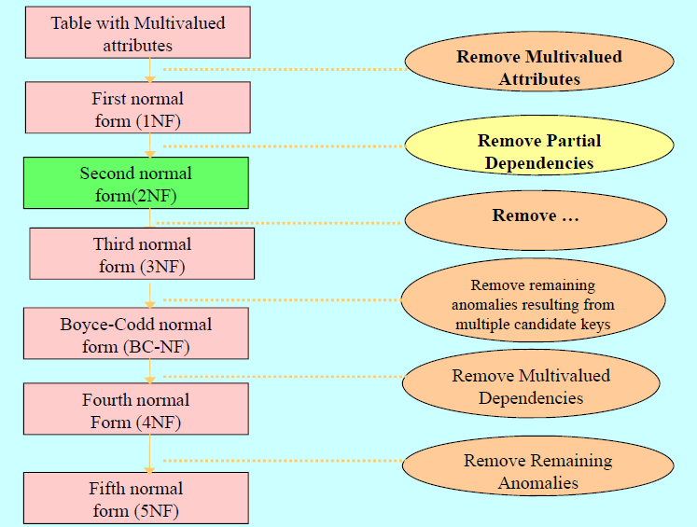
transitive dependencies

Slide 89
Steps of Normalization
Step 1. Create Unnormalized Relation
1NF
Step 2. Separate Repeating & Non-repeating Attributes
2NF
Step 3. Remove Partial Dependencies
3NF
Step 4. Remove Transitive Dependencies
4NF
Step 5. Remove Multi-Valued Dependencies
Step 6. Decompose Table Such That Further Decomposition is not Possible
5NF

